Slide 1
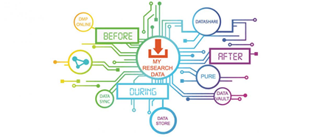
Research Data Service update
DataVault (Pauline Ward)
Data Safe Haven (Robin Rice)
Training (Kerry Miller)
Guidance and getting help (Martin Donnelly)

Slide 2
DataVault: new and improved features (PW)
Increased maximum deposit size
Review process
User roles

Slide 3
Maximum deposit size 10TB
Previously two terabytes
Now ten terabytes
Users still have the ability to add multiple deposits to a vault
Not just a configuration change – we improved the performance too

Slide 4

10 TB
~ a selfie from every person in Scotland
in a single deposit
Image: Pinhole selfie headdress; Emma Tracey; GSA; non-commercial use only.

Slide 5
Review process
Email notifies the PI and the DataVault curators (Research Data Support team) when the review date is approaching (6 months away);
A decision is needed as to whether to enable scheduled deletion of the data, or extend the retention period for some or all the deposits in a vault.
RDS team consult the PI / School / other stakeholders and then implement the agreed decision.
If some deposits are kept, a new review date is set, and the process will start over again when that date is 6 months away.

Slide 6
DataVault now has five user roles
Individual roles (applicable to one vault)
  Owner
  Nominated Data Manager
  Depositor
School roles
  School Support Officer (may access metadata on School's vaults)
  School Data Manager (may assign roles to other users on School's vaults)
  Training on School roles will take place on: Mon 26 Oct; Friday 30 October; Monday 9 Nov.
  Book now via MyEd

Slide 7
Data Safe Haven (RR)

Slide 8
What is the UoE Data Safe Haven (DSH)?
UoE DSH is a flexible, trusted research environment.
For projects requiring advanced security, the DSH provides a controlled and secured service environment for undertaking research with sensitive data.
The service provides robust controls and safeguards to enable the secure transfer of sensitive data into a highly secure environment where it can be stored, manipulated and analysed by approved members of a research team.
Any project using legally defined special categories data, or data requiring extra safeguards in processing, for example as mandated by a data controller, should consider using a data safe haven.

Slide 9
ISO 27001 accredited flexible environment
UoE DSH has ISO 27001 accredited infrastructure and operational procedures to safeguard the security of highly sensitive data.
Our environment builds are very flexible.
We can provide a research project with a standard build, or
One customised to the project’s needs.
In addition to the specifications of the standard build, additional users, software, processing capacity, and additional storage can be allocated by agreement.

Slide 10
Cost recovery
Data Safe Haven operates on a cost recovery basis; this was a condition of University investment in the facility.
Costs should be passed on to the funder in the grant application; data management planning can help to ensure requirements of costs are identified in advance.
There is an annual charge for building and maintaining a DSH environment for each project, set out according to UKRI small research facility funding guidelines. (£7,000 per annum is for a typical project, depending on requirements it may be more, or less.)
Costing is based on bespoke project requirements; Please speak with the DSH team as early as possible in your project planning, even if a funding source cannot be identified.

Slide 11
Training (KM)
Core courses & bespoke training are now being delivered online
  Additional, more skills-based courses will be rolled out in Semester 2 if possible
23 workshops or presentations are scheduled for Semester 1
  7 have already been held (since early September)
292 people have attended a course, with attendance running at 75% of those registered (which is better than usual!)
The popularity of courses has also led to additional sessions being scheduled to meet demand

Slide 12
Guidance and getting help (MD)

Slide 13
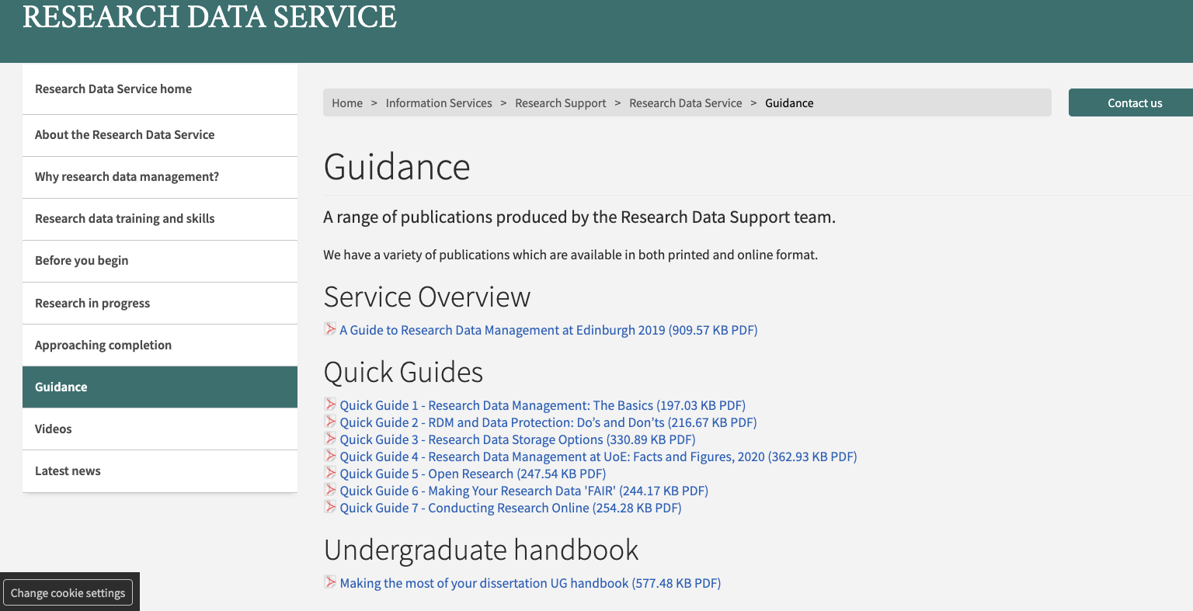
Guidance

Slide 14
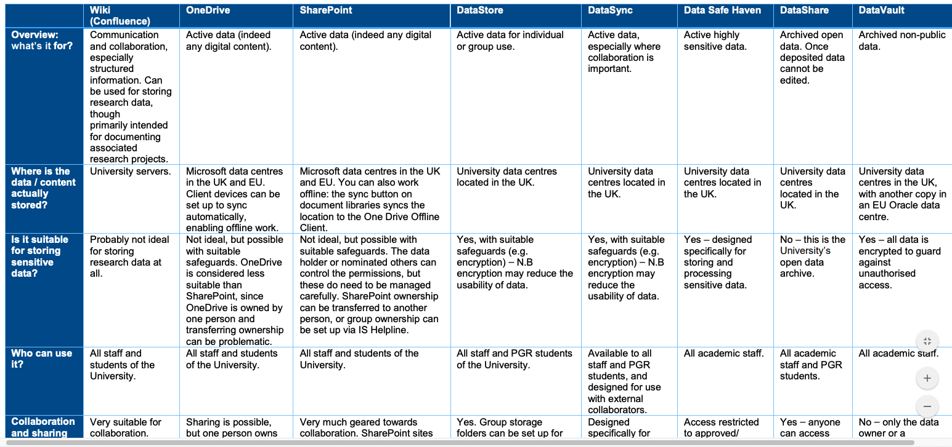

Slide 15
Getting help and staying informed
General RDM queries to data-support@ed.ac.uk
Research Data Service website: http://www.ed.ac.uk/is/research-data-service
Training courses: www.ed.ac.uk/is/data-training
Guidance documents: https://www.ed.ac.uk/information-services/research-support/research-data-service/guidance
RDS blog: http://datablog.is.ed.ac.uk
Twitter feed: https://twitter.com/ResearchDataUoE

